Slide 1

WELCOME

Slide 2
Title
Food & Beverages Sales Analysis

Slide 3
Group No. 6
Members:-
MR. MITESH R BEDRE
MR. SWAROOP H A
MR. MUTTU MANOJ KUMAR
MR. RAJEEV VARMA D
MR. AKSHAY SUDIN PATIL

Slide 4
SUMMARY
This real-time data project is designed to ensure data accuracy and reliability by using a combination of Excel, Tableau, MySQL, and Power BI.
We aim to provide actionable insights through continuous monitoring and key performance indicators (KPIs).
We used Excel for data pre-processing and validation, Tableau for interactive dashboards, MySQL for robust data storage, and Power BI for effective data visualization.
Through these tools, we try to identify the key findings and KPIs critical in assessing data correctness, helping us maintain data accuracy and make more informed decisions.

Slide 5
KPI List
Region Wise Sales
Meal Wise Sales
Top 5 Store Wise Sales
Manager Wise Sales
MTD, QTD & YTD Wise Sales
Sales Growth
Sales Comparison
Total Sales
Sales vs Budget

Slide 6
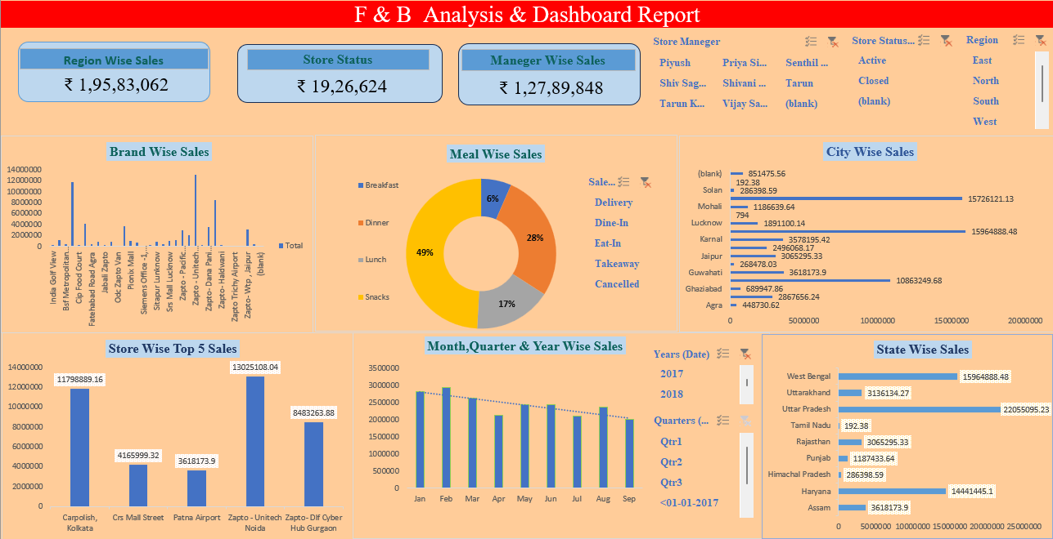
Excel

Slide 7
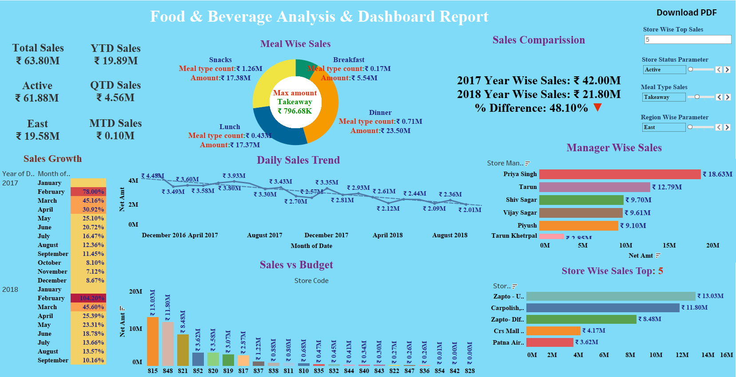
Tableau

Slide 8
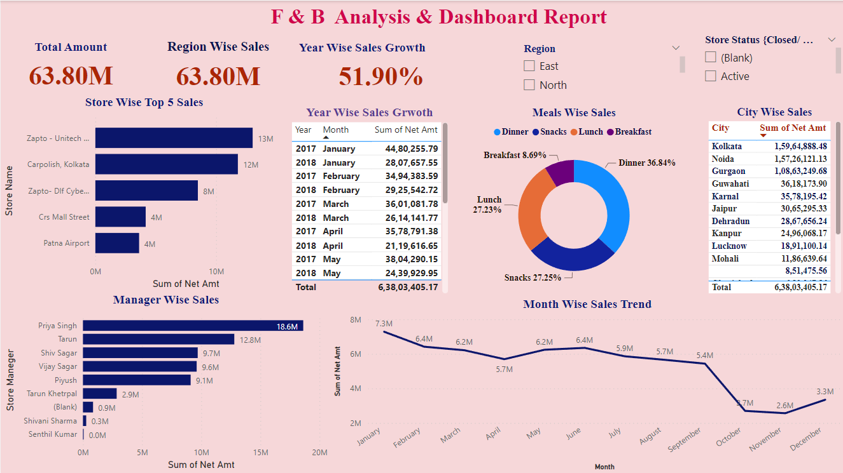
Power BI

Slide 9
CONCLUSION
Provided analytical support to Food & Beverage module, maintaining database and conducting analysis as required.
Maintained large data set and using various professional statistical tools i.e., Power Bi(Dax functions), Tableau, Advance Excel, My SQL to collect, analyze, and interpret the data.
Identified and reported the data issues, conducted weekly reports.
We could see that there is drastic downfall of 48% of Total Sales in 2018 as compared to Total Sales of 2017
Worked on the development of Dashboards in order to stabilize the business and maximize the efficiency.
This analysis provided valuable insights of the company’s financial performance.

Slide 10


